Slide 1

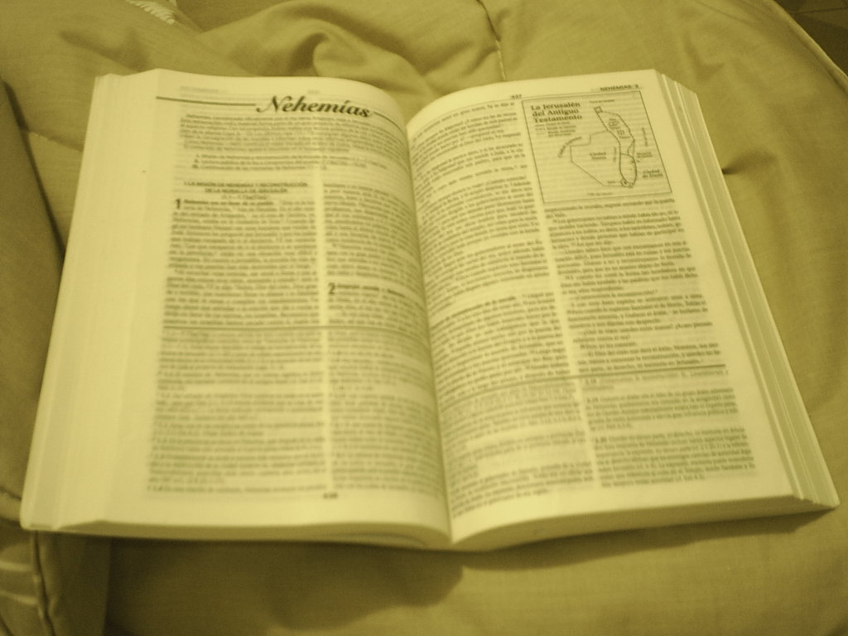
Comunicación y Gerencia
How To Study The Bible
Context, Context,Context !!!
2 Timothy 2:15

Slide 2
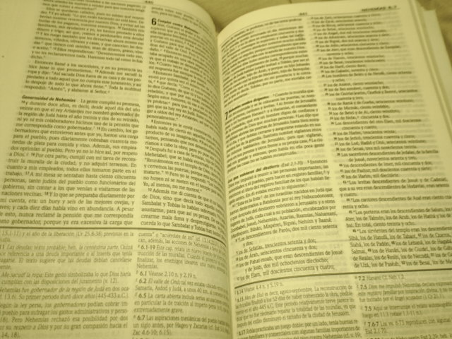
“Be diligent to present yourself approved to God as a workman who does not need to be ashamed, accurately handling the word of truth.”
(2 Timothy 2:15)

Slide 3
Learn The Facts That Prompted The Scripture

Slide 4
Who Is The Author Of The Statement?
1. Is it an inspired statement?
Matthew 18:18; 28:19-20; 1 Corinthians 14:37
2. Is it an inspired record of an uninspired statement?
  a. Acts 5:38-39; John 9:31; Proverbs 28:9
  b. cf. 1 Timothy 1:19-20; 2 Timothy 2:17-18
  –Error taught
  c. Colossians 2:20-23 –Rules of men are quoted here, but not for us to follow.
Notes:
Matthew 18:18 Truly I say to you, whatever you bind on earth shall have been bound in heaven; and whatever you loose on earth shall have been loosed in heaven.
Matthew 28:19-20 Go therefore and make disciples of all the nations, baptizing them in the name of the Father and the Son and the Holy Spirit, ²⁰ teaching them to observe all that I commanded you; and lo, I am with you always, even to the end of the age.”
1 Corinthians 14:37 If anyone thinks he is a prophet or spiritual, let him recognize that the things which I write to you are the Lord’s commandment.
Acts 5:38-39 So in the present case, I say to you, stay away from these men and let them alone, for if this plan or action is of men, it will be overthrown; ³⁹ but if it is of God, you will not be able to overthrow them; or else you may even be found fighting against God.”
John 9:31 We know that God does not hear sinners; but if anyone is God-fearing and does His will, He hears him.
Proverbs 28:9 He who turns away his ear from listening to the law, Even his prayer is an abomination.
1 Timothy 1:19-20 keeping faith and a good conscience, which some have rejected and suffered shipwreck in regard to their faith. ²⁰ Among these are Hymenaeus and Alexander, whom I have handed over to Satan, so that they will be taught not to blaspheme.
2 Timothy 2:16-18 But avoid worldly and empty chatter, for it will lead to further ungodliness, ¹⁷ and their talk will spread like gangrene. Among them are Hymenaeus and Philetus, ¹⁸ men who have gone astray from the truth saying that the resurrection has already taken place, and they upset the faith of some.
Colossians 2:20-23 If you have died with Christ to the elementary principles of the world, why, as if you were living in the world, do you submit yourself to decrees, such as, ²¹ “Do not handle, do not taste, do not touch!” ²² (which all refer to things destined to perish with use)—in accordance with the commandments and teachings of men? These are matters which have, to be sure, the appearance of wisdom in self-made religion and self-abasement and severe treatment of the body, but are of no value against fleshly indulgence.

Slide 5
Who Is The Author Of The Statement?
3. Is the passage from the Old Covenant/Testament or the New Covenant/Testament?
  a. The doctrine of Christ is found in the New Testament, Galatians 2:21; 3:23-25; 5:4
  b. The Old Testament law came to an end at the cross, Colossians 2:14-15; Hebrews 9:15-17
  c. Use of statements from the Old Covenant ...
  1 Corinthians 10:11; cf. Romans 15:4
Notes:
Galatians 2:21 I do not nullify the grace of God, for if righteousness comes through the Law, then Christ died needlessly.”
Galatians 3:23-25 But before faith came, we were kept in custody under the law, being shut up to the faith which was later to be revealed. ²⁴ Therefore the Law has become our tutor to lead us to Christ, so that we may be justified by faith. ²⁵ But now that faith has come, we are no longer under a tutor.
Galatians 5:4 You have been severed from Christ, you who are seeking to be justified by law; you have fallen from grace.
Colossians 2:14-15 having canceled out the certificate of debt consisting of decrees against us, which was hostile to us; and He has taken it out of the way, having nailed it to the cross. ¹⁵ When He had disarmed the rulers and authorities, He made a public display of them, having triumphed over them through Him.
Hebrews 9:15-17 For this reason He is the mediator of a new covenant, so that, since a death has taken place for the redemption of the transgressions that were committed under the first covenant, those who have been called may receive the promise of the eternal inheritance. ¹⁶ For where a covenant is, there must of necessity be the death of the one who made it. ¹⁷ For a covenant is valid only when men are dead, for it is never in force while the one who made it lives.
1 Corinthians 10:11 Now these things happened to them as an example, and they were written for our instruction, upon whom the ends of the ages have come.
Romans 15:4 For whatever was written in earlier times was written for our instruction, so that through perseverance and the encouragement of the Scriptures we might have hope.

Slide 6
To Whom Was The Statement Made?
1. Was it limited to a special fact situation or for general application?
  a. Genesis 6:14 “Make an ark” is obviously not a commandment for us.
  b. Matthew 3:1-6 –The baptism of John was limited for a certain period. cf. John 1:31-34
  c. Matthew 28:18-20 –The baptism of Christ is for all generations.
Notes:
Genesis 6:14 Make for yourself an ark of gopher wood; you shall make the ark with rooms, and shall cover it inside and out with pitch.
Matthew 3:1-6 Now in those days John the Baptist *came, preaching in the wilderness of Judea, saying, ² “Repent, for the kingdom of heaven is at hand.” ³ For this is the one referred to by Isaiah the prophet when he said, “The voice of one crying in the wilderness, ‘Make ready the way of the Lord, Make His paths straight!’” ⁴ Now John himself had a garment of camel’s hair and a leather belt around his waist; and his food was locusts and wild honey. ⁵ Then Jerusalem was going out to him, and all Judea and all the district around the Jordan; ⁶ and they were being baptized by him in the Jordan River, as they confessed their sins.
John 1:31-34 I did not recognize Him, but so that He might be manifested to Israel, I came baptizing in water.” ³² John testified saying, “I have seen the Spirit descending as a dove out of heaven, and He remained upon Him. ³³ I did not recognize Him, but He who sent me to baptize in water said to me, ‘He upon whom you see the Spirit descending and remaining upon Him, this is the One who baptizes in the Holy Spirit.’ ³⁴ I myself have seen, and have testified that this is the Son of God.”
Matthew 28:18-20 And Jesus came up and spoke to them, saying, “All authority has been given to Me in heaven and on earth. ¹⁹ Go therefore and make disciples of all the nations, baptizing them in the name of the Father and the Son and the Holy Spirit, ²⁰ teaching them to observe all that I commanded you; and lo, I am with you always, even to the end of the age.”

Slide 7
To Whom Was The Statement Made?
2. Was it a promise only to particular individuals or for all men?
  a. John 14:26; 16:13 –The promise of miraculous gifts of the Holy Spirit whereby one could speak by inspiration (cf. Hebrews 2:1-4) and perform healings cannot be scripturally applied today.
  b. None can add new revelations without error, Revelation 22:18-19; nor can one work the miracles like those of Bible days, e.g., blind a blasphemer, Acts 13:6-12; or raise the dead, Acts 9:36-42.
  c. However, all who “repent and are baptized”
  (Acts 2:38-39) shall receive the “gift” of the Holy Spirit, which is salvation and its attendant blessings.
Notes:
John 14:26 But the Helper, the Holy Spirit, whom the Father will send in My name, He will teach you all things, and bring to your remembrance all that I said to you.
John 16:13 But when He, the Spirit of truth, comes, He will guide you into all the truth; for He will not speak on His own initiative, but whatever He hears, He will speak; and He will disclose to you what is to come.
Hebrews 1:1-4 God, after He spoke long ago to the fathers in the prophets in many portions and in many ways, ² in these last days has spoken to us in His Son, whom He appointed heir of all things, through whom also He made the world. ³ And He is the radiance of His glory and the exact representation of His nature, and upholds all things by the word of His power. When He had made purification of sins, He sat down at the right hand of the Majesty on high, ⁴ having become as much better than the angels, as He has inherited a more excellent name than they.
Revelation 22: 18-19 I testify to everyone who hears the words of the prophecy of this book: if anyone adds to them, God will add to him the plagues which are written in this book; ¹⁹ and if anyone takes away from the words of the book of this prophecy, God will take away his part from the tree of life and from the holy city, which are written in this book.
Acts 13:6-12 When they had gone through the whole island as far as Paphos, they found a magician, a Jewish false prophet whose name was Bar-Jesus, ⁷ who was with the proconsul, Sergius Paulus, a man of intelligence. This man summoned Barnabas and Saul and sought to hear the word of God. ⁸ But Elymas the magician (for so his name is translated) was opposing them, seeking to turn the proconsul away from the faith. ⁹ But Saul, who was also known as Paul, filled with the Holy Spirit, fixed his gaze on him, ¹⁰ and said, “You who are full of all deceit and fraud, you son of the devil, you enemy of all righteousness, will you not cease to make crooked the straight ways of the Lord? ¹¹ Now, behold, the hand of the Lord is upon you, and you will be blind and not see the sun for a time.” And immediately a mist and a darkness fell upon him, and he went about seeking those who would lead him by the hand. ¹² Then the proconsul believed when he saw what had happened, being amazed at the teaching of the Lord.
Acts 9:36-42 Now in Joppa there was a disciple named Tabitha (which translated in Greek is called Dorcas); this woman was abounding with deeds of kindness and charity which she continually did. ³⁷ And it happened at that time that she fell sick and died; and when they had washed her body, they laid it in an upper room. ³⁸ Since Lydda was near Joppa, the disciples, having heard that Peter was there, sent two men to him, imploring him, “Do not delay in coming to us.” ³⁹ So Peter arose and went with them. When he arrived, they brought him into the upper room; and all the widows stood beside him, weeping and showing all the tunics and garments that Dorcas used to make while she was with them. ⁴⁰ But Peter sent them all out and knelt down and prayed, and turning to the body, he said, “Tabitha, arise.” And she opened her eyes, and when she saw Peter, she sat up. ⁴¹ And he gave her his hand and raised her up; and calling the saints and widows, he presented her alive. ⁴² It became known all over Joppa, and many believed in the Lord. ⁴³ And Peter stayed many days in Joppa with a tanner named Simon.
Acts 2:38-39 Peter said to them, “Repent, and each of you be baptized in the name of Jesus Christ for the forgiveness of your sins; and you will receive the gift of the Holy Spirit. ³⁹ For the promise is for you and your children and for all who are far off, as many as the Lord our God will call to Himself.”

Slide 8
What Is The Subject Matter?
1. Does the subject pertain to things past, present, or future?
  a. Acts 8:34 “Of whom does the prophet say this?” When the Ethiopian understood the answer, he was baptized, Acts 8:27-40. Though it was spoken in the past it had present day application.
  b. Colossians 2:14-17 – However, some commandments such as “Remember the Sabbath day,” Deuteronomy 5:12, or abstain from unclean meat, Leviticus 11, were not intended for Christians. Deuteronomy 5:1-3 cf. 2 Timothy 2:1ff
Notes:
Acts 8:27-40 So he got up and went; and there was an Ethiopian eunuch, a court official of Candace, queen of the Ethiopians, who was in charge of all her treasure; and he had come to Jerusalem to worship, ²⁸ and he was returning and sitting in his chariot, and was reading the prophet Isaiah. ²⁹ Then the Spirit said to Philip, “Go up and join this chariot.” ³⁰ Philip ran up and heard him reading Isaiah the prophet, and said, “Do you understand what you are reading?” ³¹ And he said, “Well, how could I, unless someone guides me?” And he invited Philip to come up and sit with him. ³² Now the passage of Scripture which he was reading was this: “He was led as a sheep to slaughter; And as a lamb before its shearer is silent, So He does not open His mouth. ³³ “In humiliation His judgment was taken away; Who will relate His generation? For His life is removed from the earth.” ³⁴ The eunuch answered Philip and said, “Please tell me, of whom does the prophet say this? Of himself or of someone else?” ³⁵ Then Philip opened his mouth, and beginning from this Scripture he preached Jesus to him. ³⁶ As they went along the road they came to some water; and the eunuch *said, “Look! Water! What prevents me from being baptized?” ³⁷ [And Philip said, “If you believe with all your heart, you may.” And he answered and said, “I believe that Jesus Christ is the Son of God.”] ³⁸ And he ordered the chariot to stop; and they both went down into the water, Philip as well as the eunuch, and he baptized him. ³⁹ When they came up out of the water, the Spirit of the Lord snatched Philip away; and the eunuch no longer saw him, but went on his way rejoicing. ⁴⁰ But Philip found himself at Azotus, and as he passed through he kept preaching the gospel to all the cities until he came to Caesarea.
Colossians 2:14-17 having canceled out the certificate of debt consisting of decrees against us, which was hostile to us; and He has taken it out of the way, having nailed it to the cross. ¹⁵ When He had disarmed the rulers and authorities, He made a public display of them, having triumphed over them through Him. ¹⁶ Therefore no one is to act as your judge in regard to food or drink or in respect to a festival or a new moon or a Sabbath day— ¹⁷ things which are a mere shadow of what is to come; but the substance belongs to Christ.
Deuteronomy 5:1-3 Then Moses summoned all Israel and said to them: “Hear, O Israel, the statutes and the ordinances which I am speaking today in your hearing, that you may learn them and observe them carefully. ² The Lord our God made a covenant with us at Horeb. ³ The Lord did not make this covenant with our fathers, but with us, with all those of us alive here today.
2 Timothy 2:1-2 You therefore, my son, be strong in the grace that is in Christ Jesus. ² The things which you have heard from me in the presence of many witnesses, entrust these to faithful men who will be able to teach others also.
Acts

Slide 9
What Is The Subject Matter?
2. Is the subject the same as the isolated passage may seem to indicate?
  a. Hebrews 5:4 is sometimes applied to support the theory that preachers are specifically called by God. cf. Acts 2:21; Romans 10:1-17
  b. All men are “called” by the gospel.
  2 Thessalonians 2:14-15
Notes:
Hebrews 5:4 And no one takes the honor to himself, but receives it when he is called by God, even as Aaron was.
Acts 2:21 ‘And it shall be that everyone who calls on the name of the Lord will be saved.’
Romans 10:1-17 Brethren, my heart’s desire and my prayer to God for them is for their salvation. ² For I testify about them that they have a zeal for God, but not in accordance with knowledge. ³ For not knowing about God’s righteousness and seeking to establish their own, they did not subject themselves to the righteousness of God. ⁴ For Christ is the end of the law for righteousness to everyone who believes. ⁵ For Moses writes that the man who practices the righteousness which is based on law shall live by that righteousness. ⁶ But the righteousness based on faith speaks as follows: “Do not say in your heart, ‘Who will ascend into heaven?’ (that is, to bring Christ down), ⁷ or ‘Who will descend into the abyss?’ (that is, to bring Christ up from the dead).” ⁸ But what does it say? “The word is near you, in your mouth and in your heart”—that is, the word of faith which we are preaching, ⁹ that if you confess with your mouth Jesus as Lord, and believe in your heart that God raised Him from the dead, you will be saved; ¹⁰ for with the heart a person believes, resulting in righteousness, and with the mouth he confesses, resulting in salvation. ¹¹ For the Scripture says, “Whoever believes in Him will not be disappointed.” ¹² For there is no distinction between Jew and Greek; for the same Lord is Lord of all, abounding in riches for all who call on Him; ¹³ for “Whoever will call on the name of the Lord will be saved.” ¹⁴ How then will they call on Him in whom they have not believed? How will they believe in Him whom they have not heard? And how will they hear without a preacher? ¹⁵ How will they preach unless they are sent? Just as it is written, “How beautiful are the feet of those who bring good news of good things!” ¹⁶ However, they did not all heed the good news; for Isaiah says, “Lord, who has believed our report?” ¹⁷ So faith comes from hearing, and hearing by the word of Christ.
2 Thessalonians 2:14-15 It was for this He called you through our gospel, that you may gain the glory of our Lord Jesus Christ. ¹⁵ So then, brethren, stand firm and hold to the traditions which you were taught, whether by word of mouth or by letter from us.

Slide 10
What Was The Purpose To Be Accomplished?
Most passages that require careful consideration have a special object to accomplish. It may be to prevent an error or to correct one. It may be to remove a special difficulty or to prompt particular duties.
Examples:
a. The fact that Matthew’s Gospel was written from the Jewish point of view explains why the genealogy of Jesus was traced to David and Abraham and why emphasis is given to the fulfillment of prophecy.

Slide 11
What Was The Purpose To Be Accomplished?
b. The book of Revelation was written during a time of persecution to assure Christians that truth and righteousness would ultimately triumph over evil and error, and thus to give them the hope and patience they needed to endure. cf. Revelation 1:1ff
c. The tendency of Jewish Christians to return to the traditional practices of the Law of Moses prompted several letters of the New Testament. Galatians, Romans, and Hebrews were written especially to prevent such apostasy.
Notes:
Revelation 1:1-3 The Revelation of Jesus Christ, which God gave Him to show to His bond-servants, the things which must soon take place; and He sent and communicated it by His angel to His bond-servant John, ² who testified to the word of God and to the testimony of Jesus Christ, even to all that he saw. ³ Blessed is he who reads and those who hear the words of the prophecy, and heed the things which are written in it; for the time is near.

Slide 12
Gain A Knowledge Of The Background Of The Text

Slide 13
Learn About The History Of The Times And The Geography Of The Country
The historical fact that the Romans had conquered the Jews and that Judea had a dual form of government in the time of Christ helps in understanding the trial of Christ as well as many other events of the New Testament.

Slide 14
Learn About The History Of The Times And The Geography Of The Country
a. Jesus was first examined by the Jews:
  (1) Annas, John 18:12-14, 19-23;
  (2) Caiaphas and the Sanhedrin, John 18:24-27; Matthew 26:57-68.
b. He was then delivered to Pilate, the Roman governor, Matthew 27:1-2, 12-14; John 18:28-38; Luke 23:1-5.
c. Pilate sent Jesus to Herod Antipas, king of the Jews, Luke 23:6-12.
d. Herod sent Him back to Pilate, Luke 23:13-23; Matthew 27:15-23; John 19:1-16.
Notes:
John 18:12-14 So the Roman cohort and the commander and the officers of the Jews, arrested Jesus and bound Him, ¹³ and led Him to Annas first; for he was father-in-law of Caiaphas, who was high priest that year. ¹⁴ Now Caiaphas was the one who had advised the Jews that it was expedient for one man to die on behalf of the people.
John 18:19-23 The high priest then questioned Jesus about His disciples, and about His teaching. ²⁰ Jesus answered him, “I have spoken openly to the world; I always taught in synagogues and in the temple, where all the Jews come together; and I spoke nothing in secret. ²¹ Why do you question Me? Question those who have heard what I spoke to them; they know what I said.” ²² When He had said this, one of the officers standing nearby struck Jesus, saying, “Is that the way You answer the high priest?” ²³ Jesus answered him, “If I have spoken wrongly, testify of the wrong; but if rightly, why do you strike Me?”
John 18:24-27So Annas sent Him bound to Caiaphas the high priest. ²⁵ Now Simon Peter was standing and warming himself. So they said to him, “You are not also one of His disciples, are you?” He denied it, and said, “I am not.” ²⁶ One of the slaves of the high priest, being a relative of the one whose ear Peter cut off, *said, “Did I not see you in the garden with Him?” ²⁷ Peter then denied it again, and immediately a rooster crowed.
Matthew 26:57-68 Those who had seized Jesus led Him away to Caiaphas, the high priest, where the scribes and the elders were gathered together. ⁵⁸ But Peter was following Him at a distance as far as the courtyard of the high priest, and entered in, and sat down with the officers to see the outcome. ⁵⁹ Now the chief priests and the whole Council kept trying to obtain false testimony against Jesus, so that they might put Him to death. ⁶⁰ They did not find any, even though many false witnesses came forward. But later on two came forward, ⁶¹ and said, “This man stated, ‘I am able to destroy the temple of God and to rebuild it in three days.’” ⁶² The high priest stood up and said to Him, “Do You not answer? What is it that these men are testifying against You?” ⁶³ But Jesus kept silent. And the high priest said to Him, “I adjure You by the living God, that You tell us whether You are the Christ, the Son of God.” ⁶⁴ Jesus *said to him, “You have said it yourself; nevertheless I tell you, hereafter you will see the Son of Man sitting at the right hand of Power, and coming on the clouds of heaven.” ⁶⁵ Then the high priest tore his robes and said, “He has blasphemed! What further need do we have of witnesses? Behold, you have now heard the blasphemy; ⁶⁶ what do you think?” They answered, “He deserves death!” ⁶⁷ Then they spat in His face and beat Him with their fists; and others slapped Him, ⁶⁸ and said, “Prophesy to us, You Christ; who is the one who hit You?”
Matthew 27:1-2 Now when morning came, all the chief priests and the elders of the people conferred together against Jesus to put Him to death; ² and they bound Him, and led Him away and delivered Him to Pilate the governor.
Matthew 27:12-14 And while He was being accused by the chief priests and elders, He did not answer. ¹³ Then Pilate *said to Him, “Do You not hear how many things they testify against You?” ¹⁴ And He did not answer him with regard to even a single charge, so the governor was quite amazed.
John 18:28-38 Then they *led Jesus from Caiaphas into the Praetorium, and it was early; and they themselves did not enter into the Praetorium so that they would not be defiled, but might eat the Passover. ²⁹ Therefore Pilate went out to them and *said, “What accusation do you bring against this Man?” ³⁰ They answered and said to him, “If this Man were not an evildoer, we would not have delivered Him to you.” ³¹ So Pilate said to them, “Take Him yourselves, and judge Him according to your law.” The Jews said to him, “We are not permitted to put anyone to death,” ³² to fulfill the word of Jesus which He spoke, signifying by what kind of death He was about to die. ³³ Therefore Pilate entered again into the Praetorium, and summoned Jesus and said to Him, “Are You the King of the Jews?” ³⁴ Jesus answered, “Are you saying this on your own initiative, or did others tell you about Me?” ³⁵ Pilate answered, “I am not a Jew, am I? Your own nation and the chief priests delivered You to me; what have You done?” ³⁶ Jesus answered, “My kingdom is not of this world. If My kingdom were of this world, then My servants would be fighting so that I would not be handed over to the Jews; but as it is, My kingdom is not of this realm.” ³⁷ Therefore Pilate said to Him, “So You are a king?” Jesus answered, “You say correctly that I am a king. For this I have been born, and for this I have come into the world, to testify to the truth. Everyone who is of the truth hears My voice.” ³⁸ Pilate *said to Him, “What is truth?” And when he had said this, he went out again to the Jews and *said to them, “I find no guilt in Him.
Luke 23:1-5 Then the whole body of them got up and brought Him before Pilate. ² And they began to accuse Him, saying, “We found this man misleading our nation and forbidding to pay taxes to Caesar, and saying that He Himself is Christ, a King.” ³ So Pilate asked Him, saying, “Are You the King of the Jews?” And He answered him and said, “It is as you say.” ⁴ Then Pilate said to the chief priests and the crowds, “I find no guilt in this man.” ⁵ But they kept on insisting, saying, “He stirs up the people, teaching all over Judea, starting from Galilee even as far as this place.”
Luke 23:6-12 When Pilate heard it, he asked whether the man was a Galilean. ⁷ And when he learned that He belonged to Herod’s jurisdiction, he sent Him to Herod, who himself also was in Jerusalem at that time. ⁸ Now Herod was very glad when he saw Jesus; for he had wanted to see Him for a long time, because he had been hearing about Him and was hoping to see some sign performed by Him. ⁹ And he questioned Him at some length; but He answered him nothing. ¹⁰ And the chief priests and the scribes were standing there, accusing Him vehemently. ¹¹ And Herod with his soldiers, after treating Him with contempt and mocking Him, dressed Him in a gorgeous robe and sent Him back to Pilate. ¹² Now Herod and Pilate became friends with one another that very day; for before they had been enemies with each other.
Luke 23:13-23 Pilate summoned the chief priests and the rulers and the people, ¹⁴ and said to them, “You brought this man to me as one who incites the people to rebellion, and behold, having examined Him before you, I have found no guilt in this man regarding the charges which you make against Him. ¹⁵ No, nor has Herod, for he sent Him back to us; and behold, nothing deserving death has been done by Him. ¹⁶ Therefore I will punish Him and release Him.” ¹⁷ [Now he was obliged to release to them at the feast one prisoner.] ¹⁸ But they cried out all together, saying, “Away with this man, and release for us Barabbas!” ¹⁹ (He was one who had been thrown into prison for an insurrection made in the city, and for murder.) ²⁰ Pilate, wanting to release Jesus, addressed them again, ²¹ but they kept on calling out, saying, “Crucify, crucify Him!” ²² And he said to them the third time, “Why, what evil has this man done? I have found in Him no guilt demanding death; therefore I will punish Him and release Him.” ²³ But they were insistent, with loud voices asking that He be crucified. And their voices began to prevail.
Matthew 27:15-23 Now at the feast the governor was accustomed to release for the people any one prisoner whom they wanted. ¹⁶ At that time they were holding a notorious prisoner, called Barabbas. ¹⁷ So when the people gathered together, Pilate said to them, “Whom do you want me to release for you? Barabbas, or Jesus who is called Christ?” ¹⁸ For he knew that because of envy they had handed Him over.
¹⁹ While he was sitting on the judgment seat, his wife sent him a message, saying, “Have nothing to do with that righteous Man; for last night I suffered greatly in a dream because of Him.” ²⁰ But the chief priests and the elders persuaded the crowds to ask for Barabbas and to put Jesus to death. ²¹ But the governor said to them, “Which of the two do you want me to release for you?” And they said, “Barabbas.” ²² Pilate *said to them, “Then what shall I do with Jesus who is called Christ?” They all *said, “Crucify Him!” ²³ And he said, “Why, what evil has He done?” But they kept shouting all the more, saying, “Crucify Him!”
John 19:1-16 Pilate then took Jesus and scourged Him. ² And the soldiers twisted together a crown of thorns and put it on His head, and put a purple robe on Him; ³ and they began to come up to Him and say, “Hail, King of the Jews!” and to give Him slaps in the face. ⁴ Pilate came out again and *said to them, “Behold, I am bringing Him out to you so that you may know that I find no guilt in Him.” ⁵ Jesus then came out, wearing the crown of thorns and the purple robe. Pilate *said to them, “Behold, the Man!” ⁶ So when the chief priests and the officers saw Him, they cried out saying, “Crucify, crucify!” Pilate *said to them, “Take Him yourselves and crucify Him, for I find no guilt in Him.” ⁷ The Jews answered him, “We have a law, and by that law He ought to die because He made Himself out to be the Son of God.”
⁸ Therefore when Pilate heard this statement, he was even more afraid; ⁹ and he entered into the Praetorium again and *said to Jesus, “Where are You from?” But Jesus gave him no answer. ¹⁰ So Pilate *said to Him, “You do not speak to me? Do You not know that I have authority to release You, and I have authority to crucify You?” ¹¹ Jesus answered, “You would have no authority over Me, unless it had been given you from above; for this reason he who delivered Me to you has the greater sin.” ¹² As a result of this Pilate made efforts to release Him, but the Jews cried out saying, “If you release this Man, you are no friend of Caesar; everyone who makes himself out to be a king opposes Caesar.”
¹³ Therefore when Pilate heard these words, he brought Jesus out, and sat down on the judgment seat at a place called The Pavement, but in Hebrew, Gabbatha. ¹⁴ Now it was the day of preparation for the Passover; it was about the sixth hour. And he *said to the Jews, “Behold, your King!” ¹⁵ So they cried out, “Away with Him, away with Him, crucify Him!” Pilate *said to them, “Shall I crucify your King?” The chief priests answered, “We have no king but Caesar.” ¹⁶ So he then handed Him over to them to be crucified.

Slide 15
Learn About The History Of The Times And The Geography Of The Country
Observe the geography of the land and countries being studied.
(Study the maps…)

Slide 16
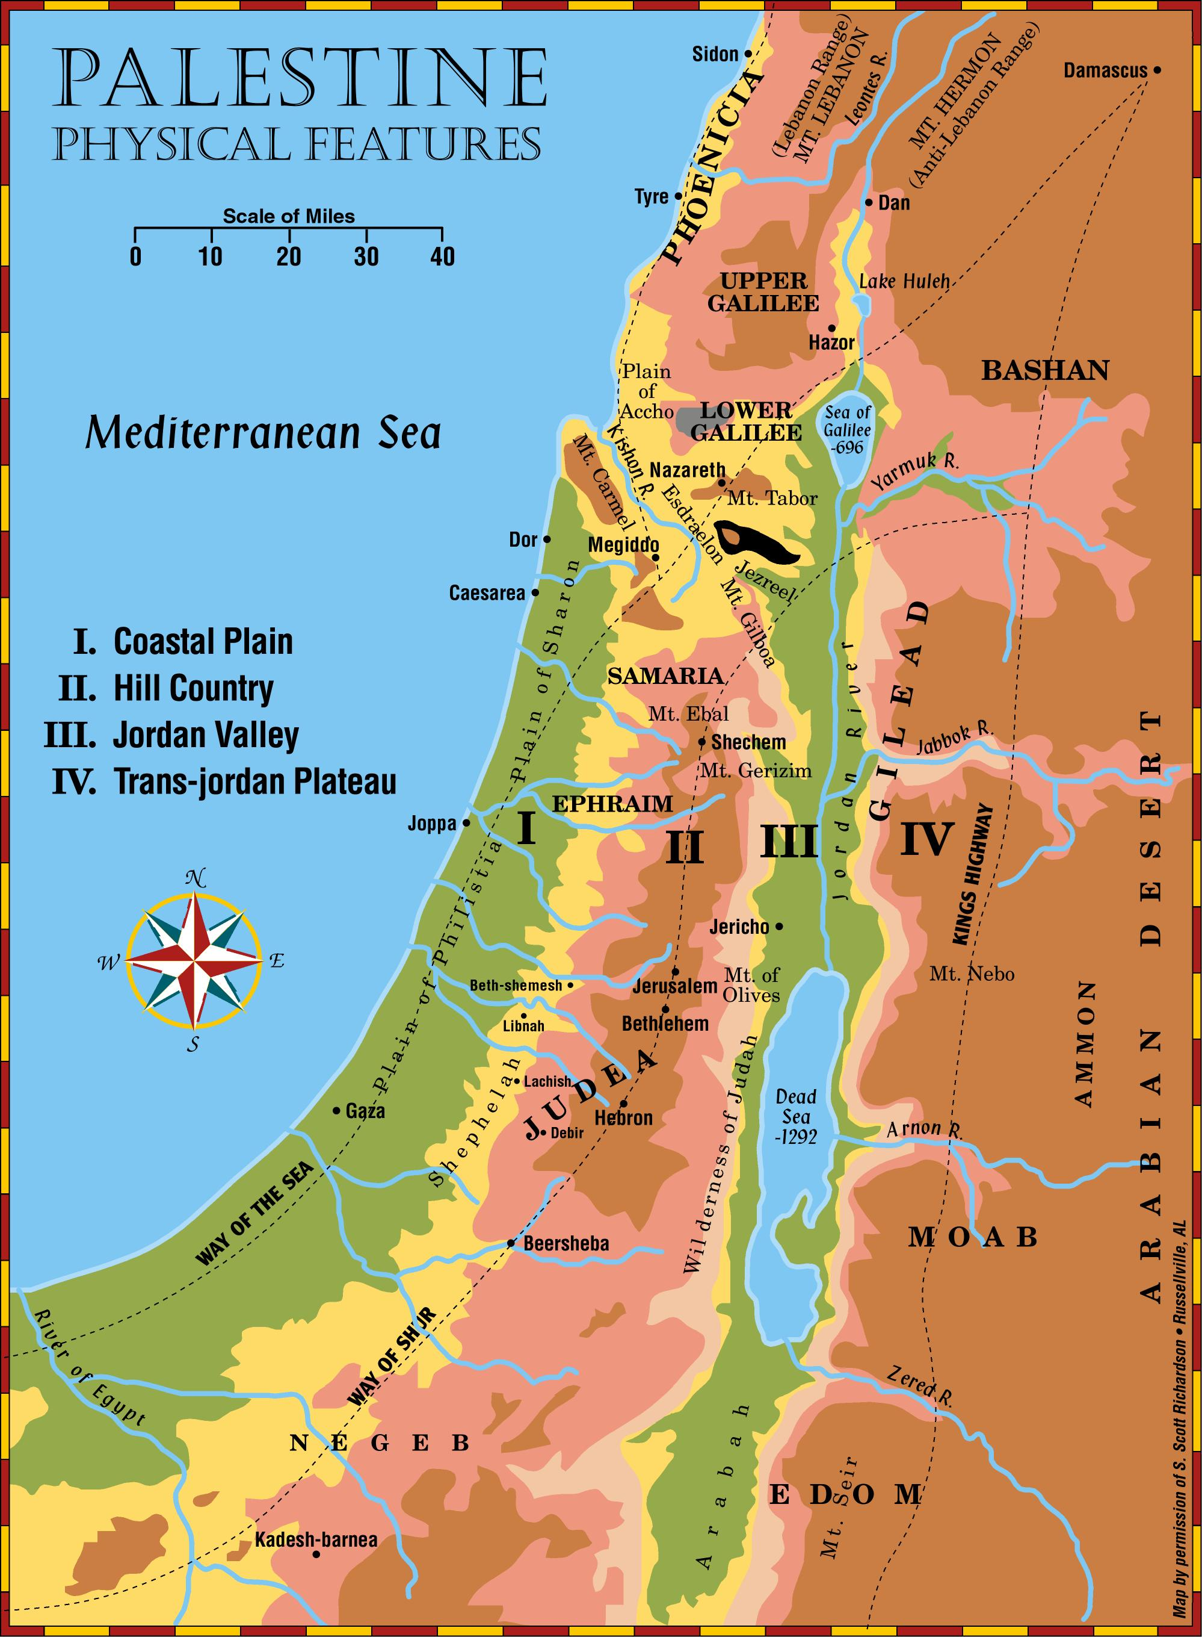
(Now drained and
cultivated)
(controlled by Syria)
Jordan Valley
Trans-Jordan Plateau
.Bethel
Coastal Plain
Hill country
1300 ft. deep
Page 10

Slide 17
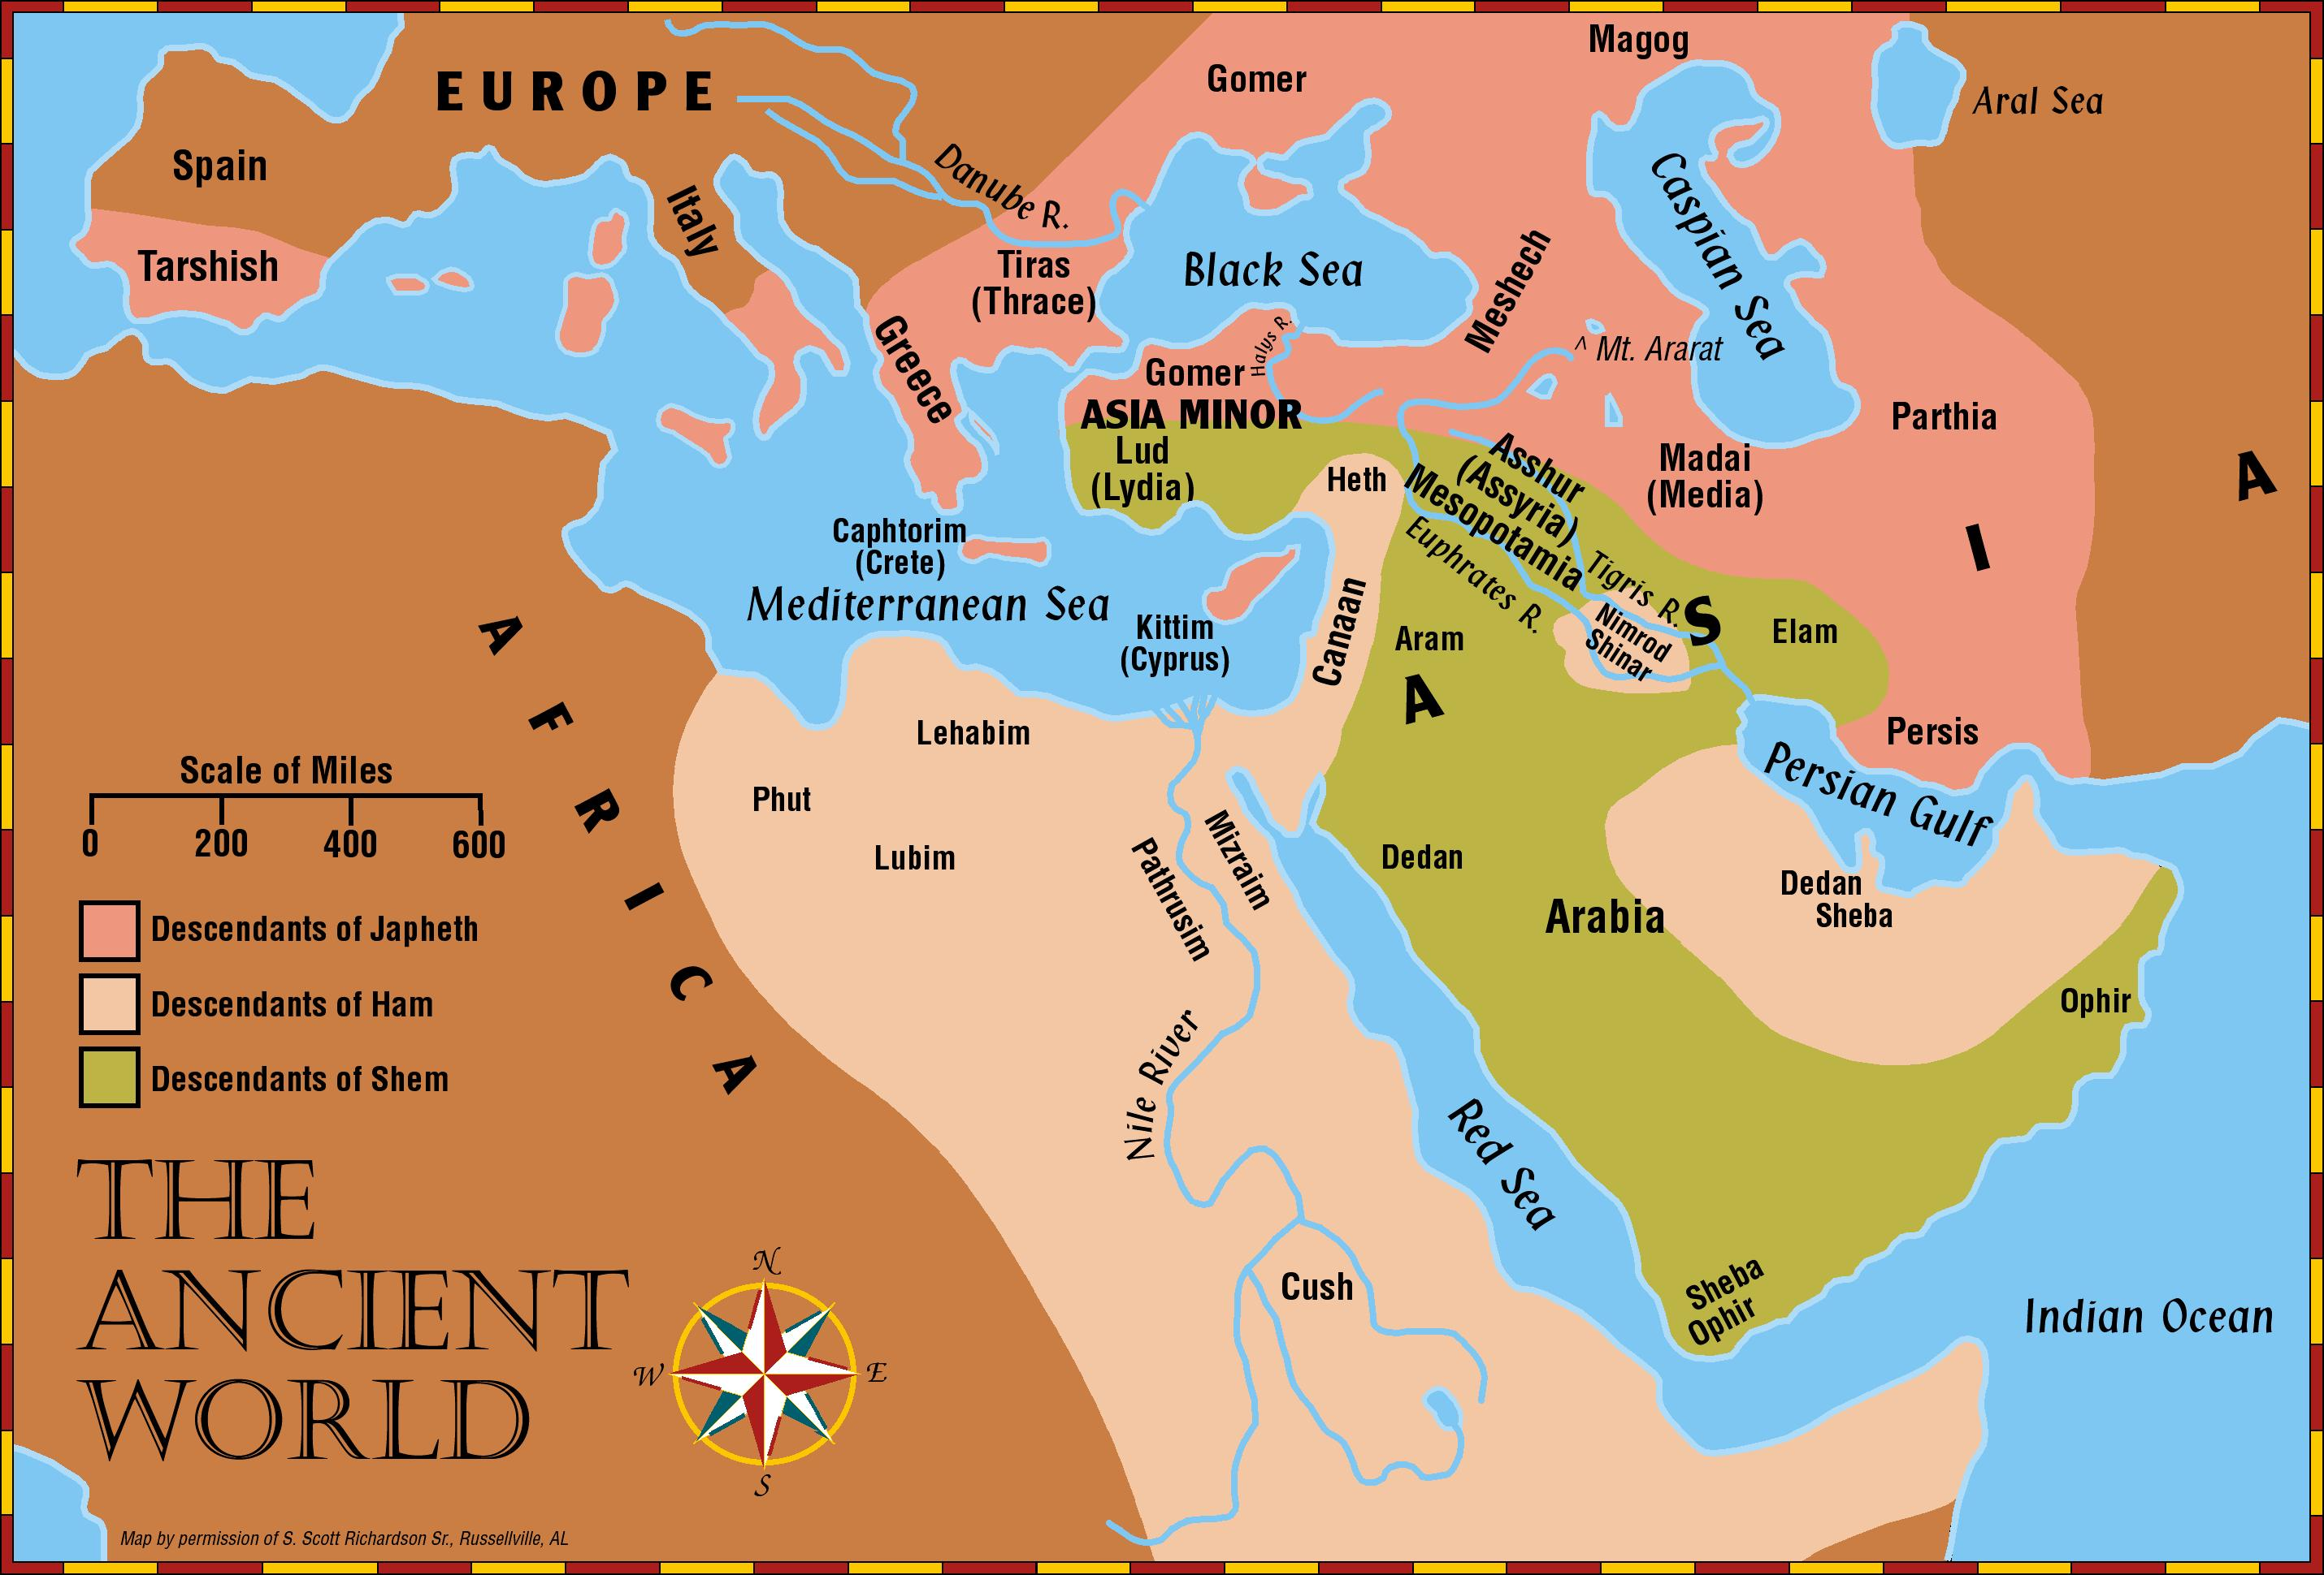
Page 37

Slide 18
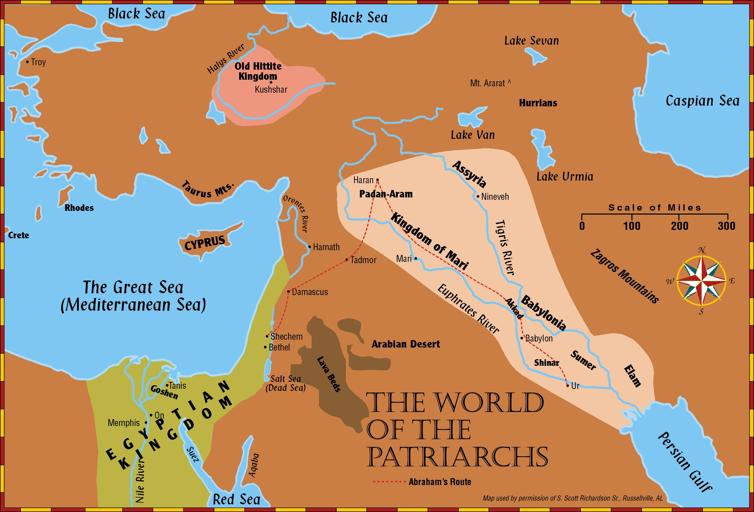
Page 42

Slide 19
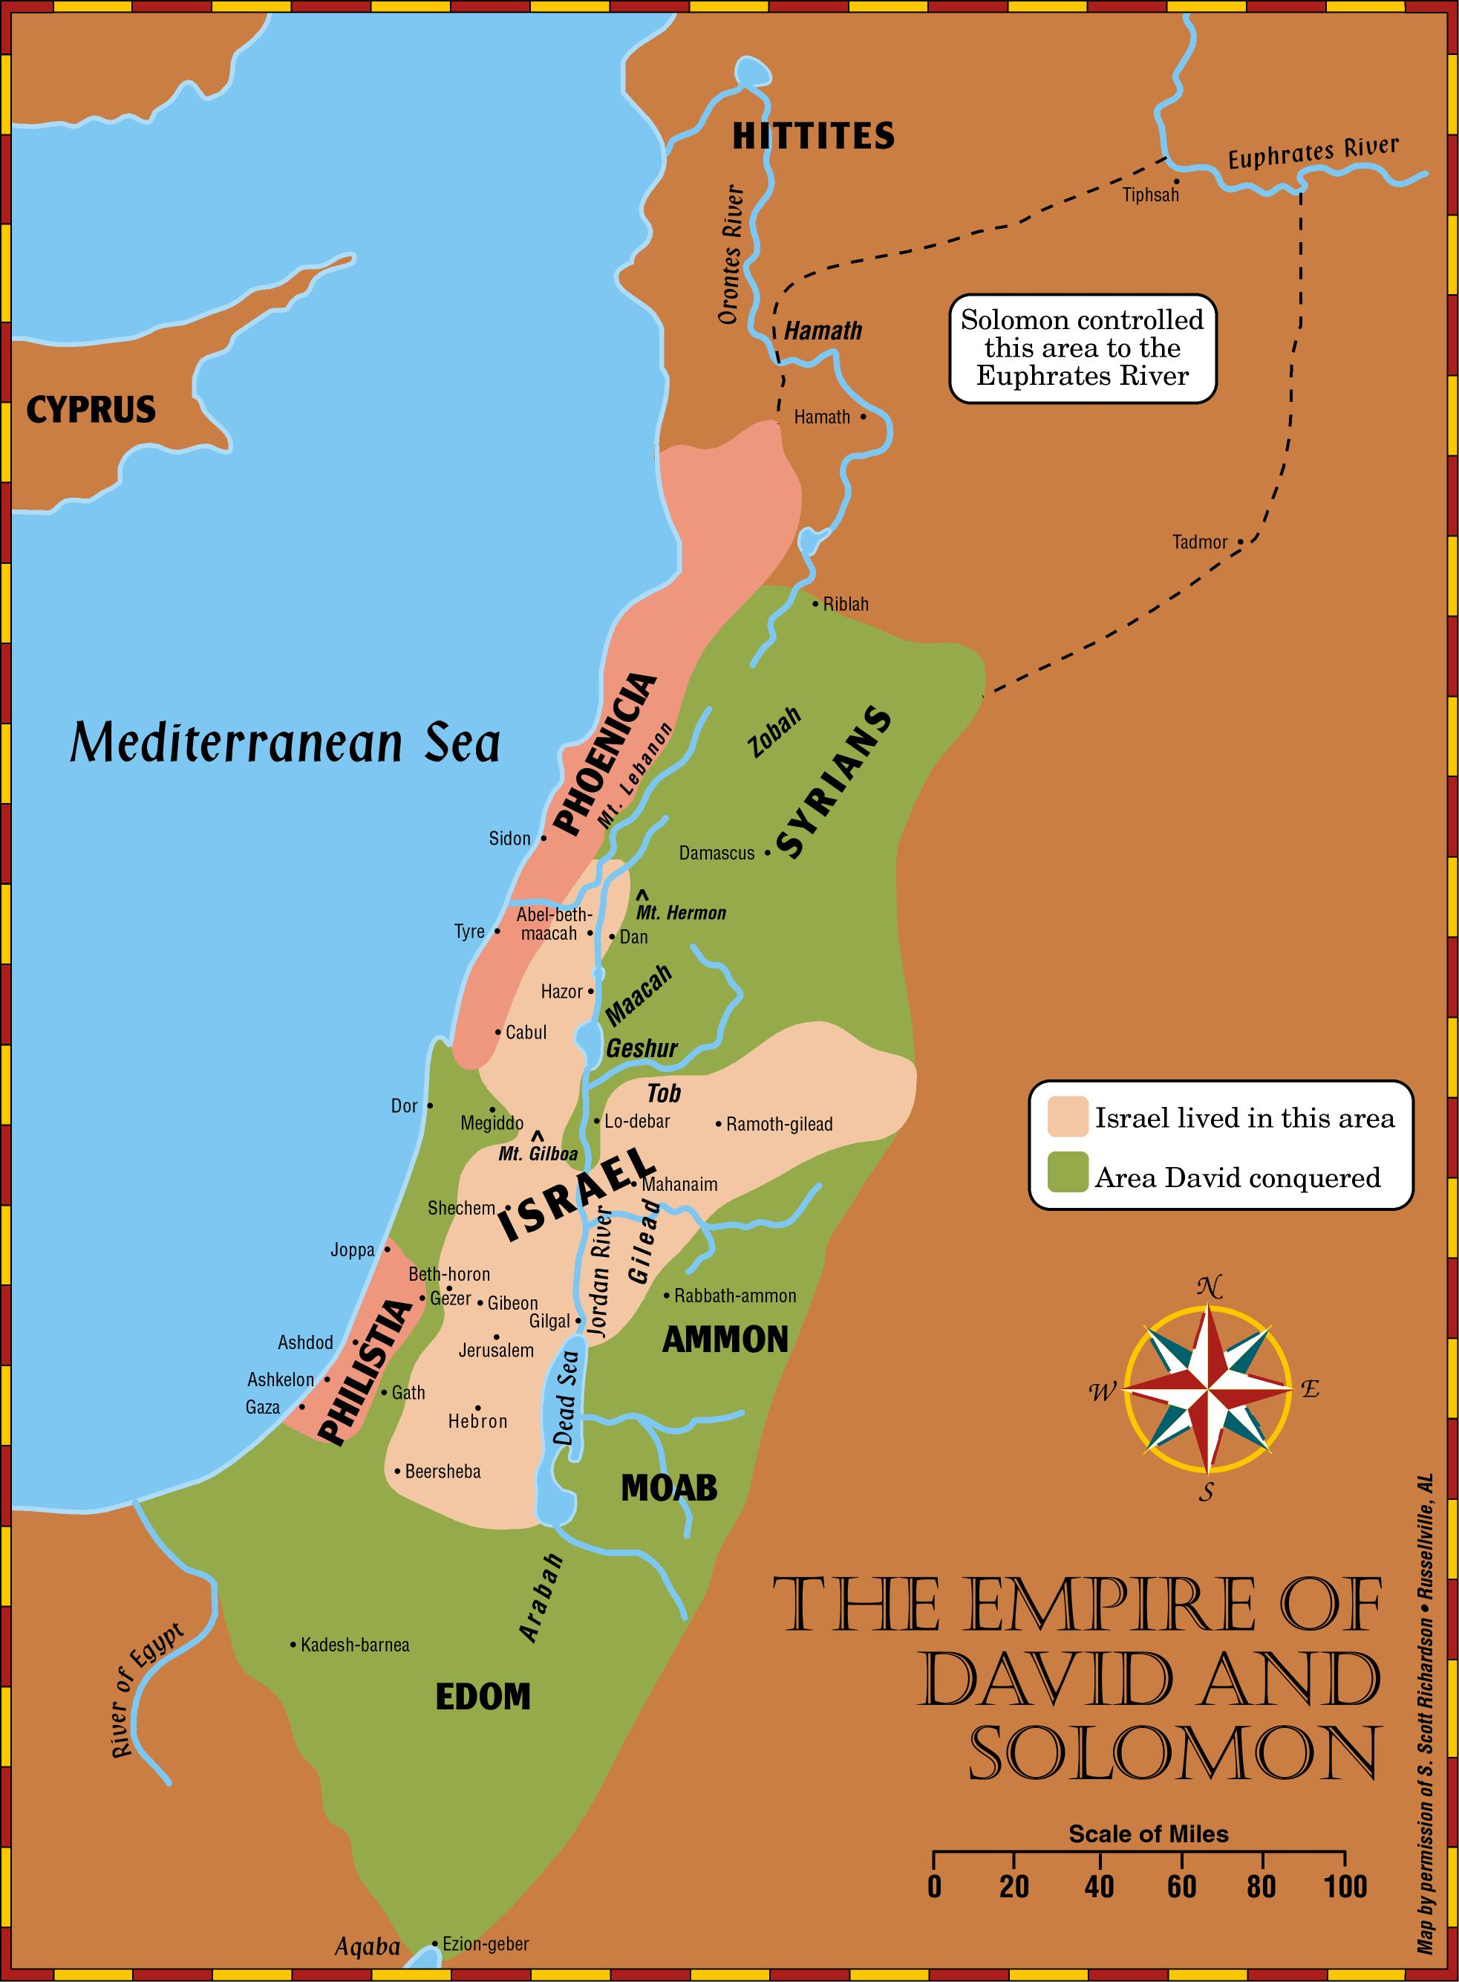
Page 91

Slide 20
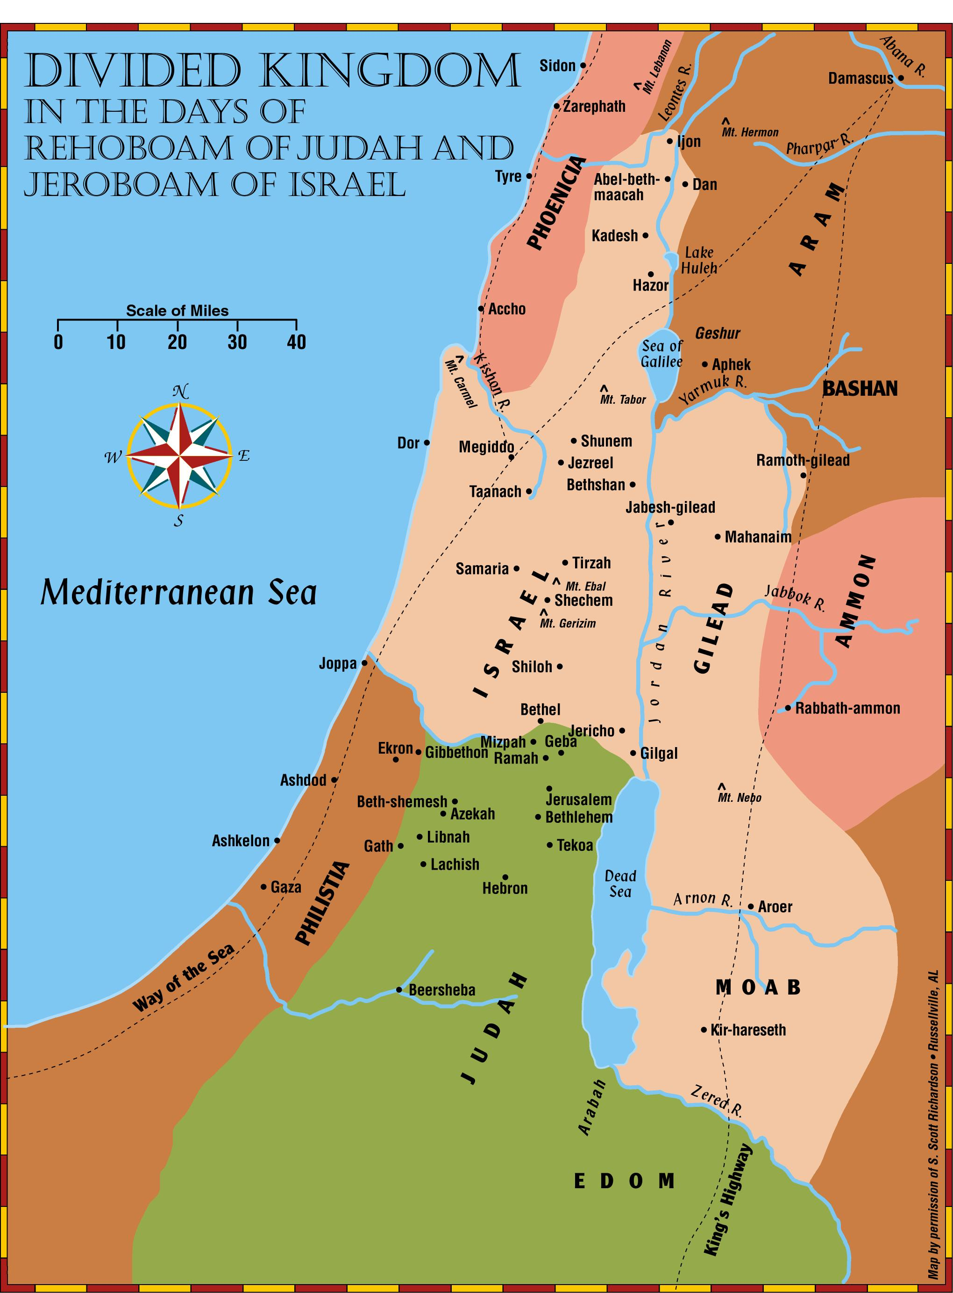
Page 101

Slide 21
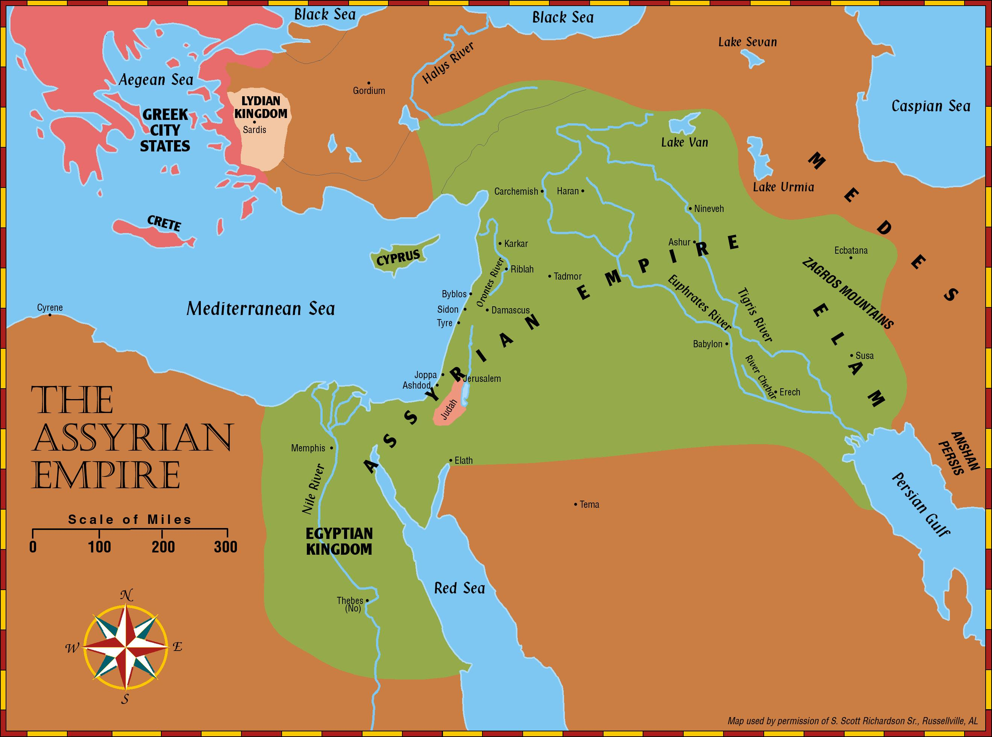
Page 121

Slide 22
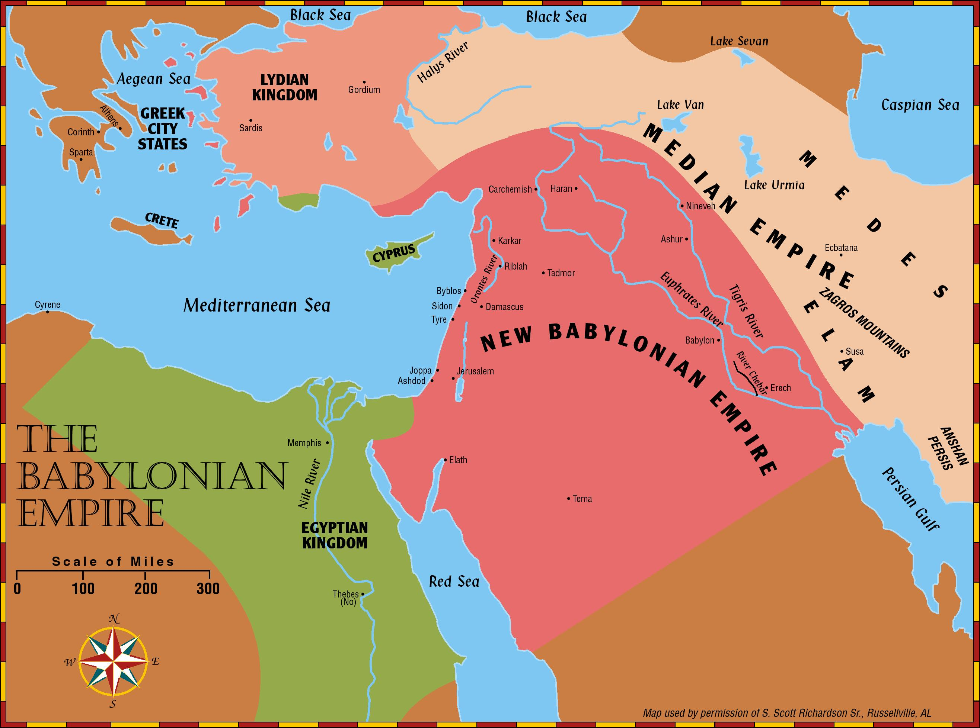
Page 136

Slide 23
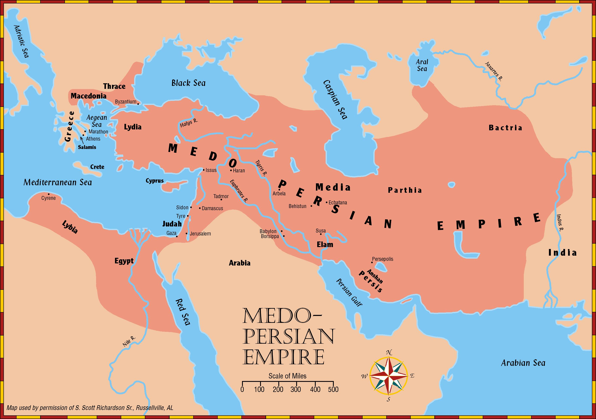

Slide 24
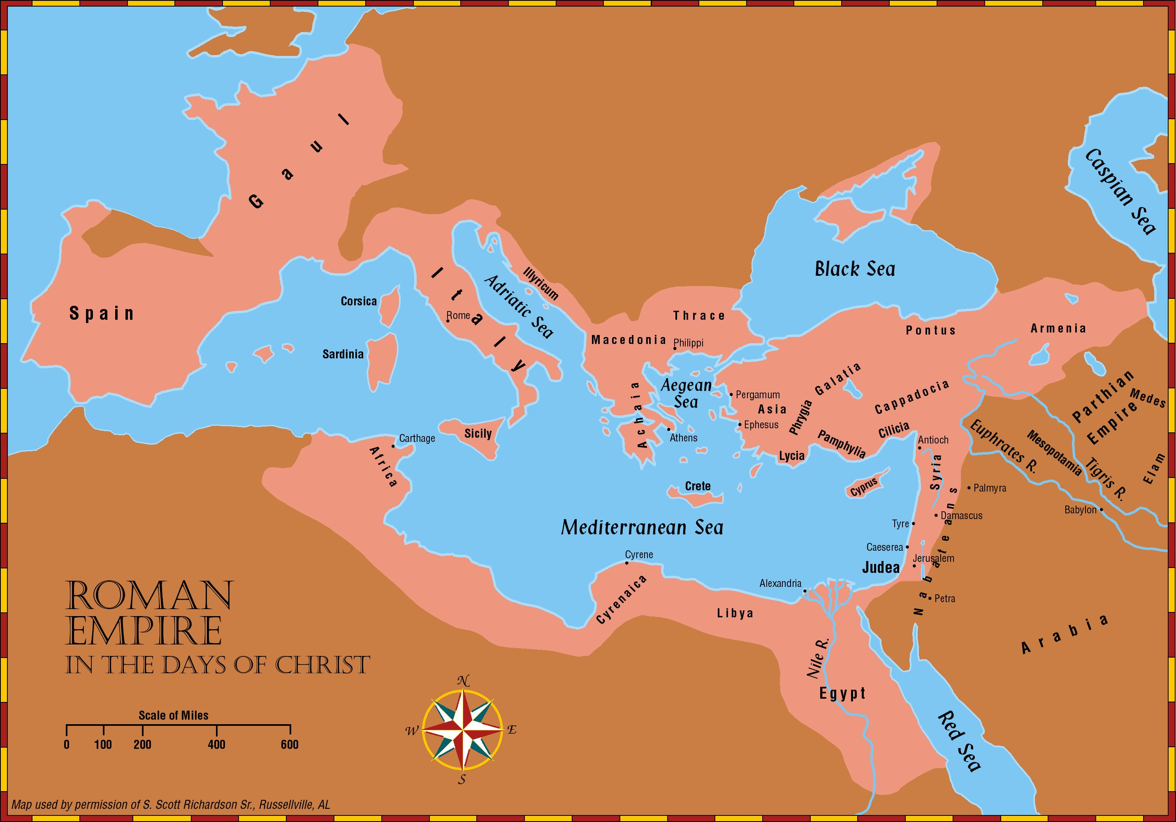
Cf. Pg. 22

Slide 25
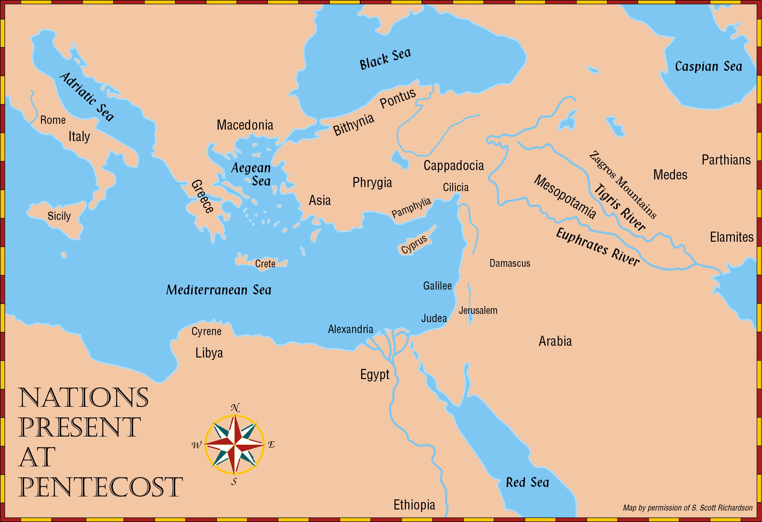
Mt. Ararat
Hittites
Philippi
Halys River
Achaia
Nineveh
Athens
Ephesus
& Persians
Corinth
Antioch of
Syria
Melita
Tit. 1:12
Palestine
Nabateans
New
Testament
Lands

Slide 26
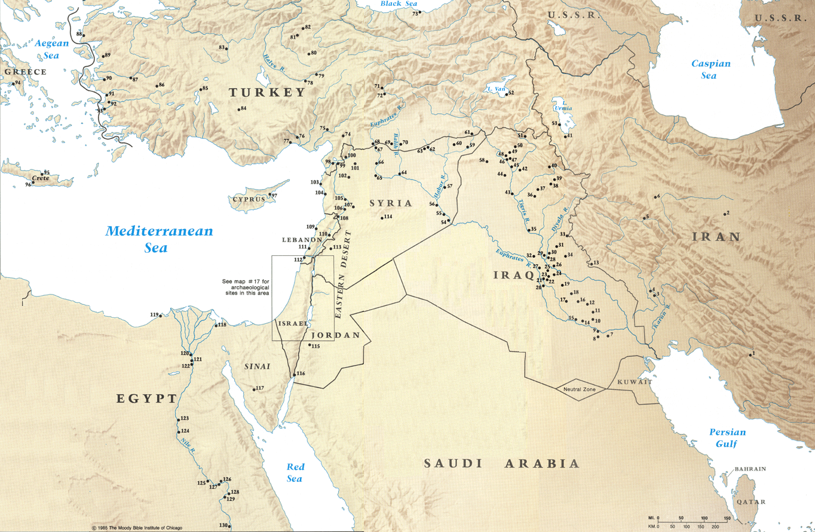

Slide 27
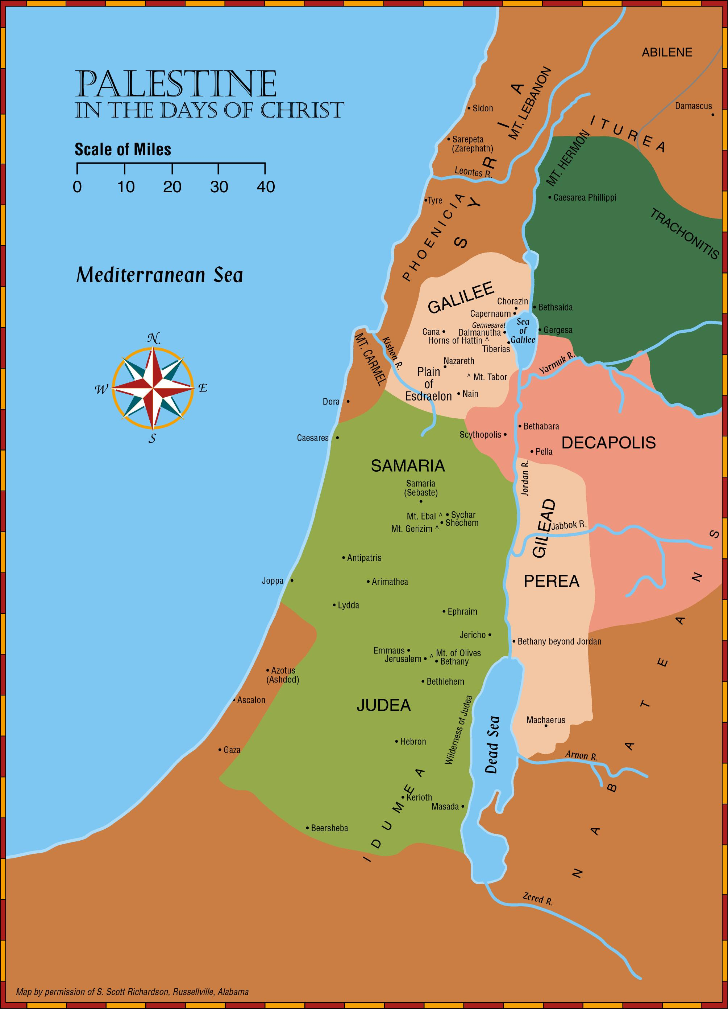
Jerusalem:
-Passover, Pentecost & Attonement (Lev. 23; Deut. 16:16)
-Feast of Purim (Est. 9:20-28)
-Feast of Dedication (Jn. 10:22-23)
-Gathering place for scribes and learned men. (Mt. 26:57; Ax. 3:17; 1 Cor. 2:8; Ax. 5:27-28)
-Common people heard Jesus gladly. (Mk. 12:37; cf. Mk. 6:20)
Bethlehem of Judea:
-Actually two cities named Bethlehem. (Micah 5:2; Josh. 19:15
-Ruth the Moabites. (Book of Ruth)
-David tended sheep. (1 Sam. 16)
-Jacob buried Rachael after the birth of Benjamin (Gen. 35:16-20)
Nazareth:
-Joseph took his family to Nazareth after fleeing to Egypt. (Mt. 2:22-23; cf. Jno. 1:46)
-Here Jesus grew up as a carpenter. (Mk. 6:3)
-People of Nazareth refused to believe he was the Messiah. (Mt. 13:53-58; Mk. 6:1-6; Lk. 4:16-30)

Slide 28
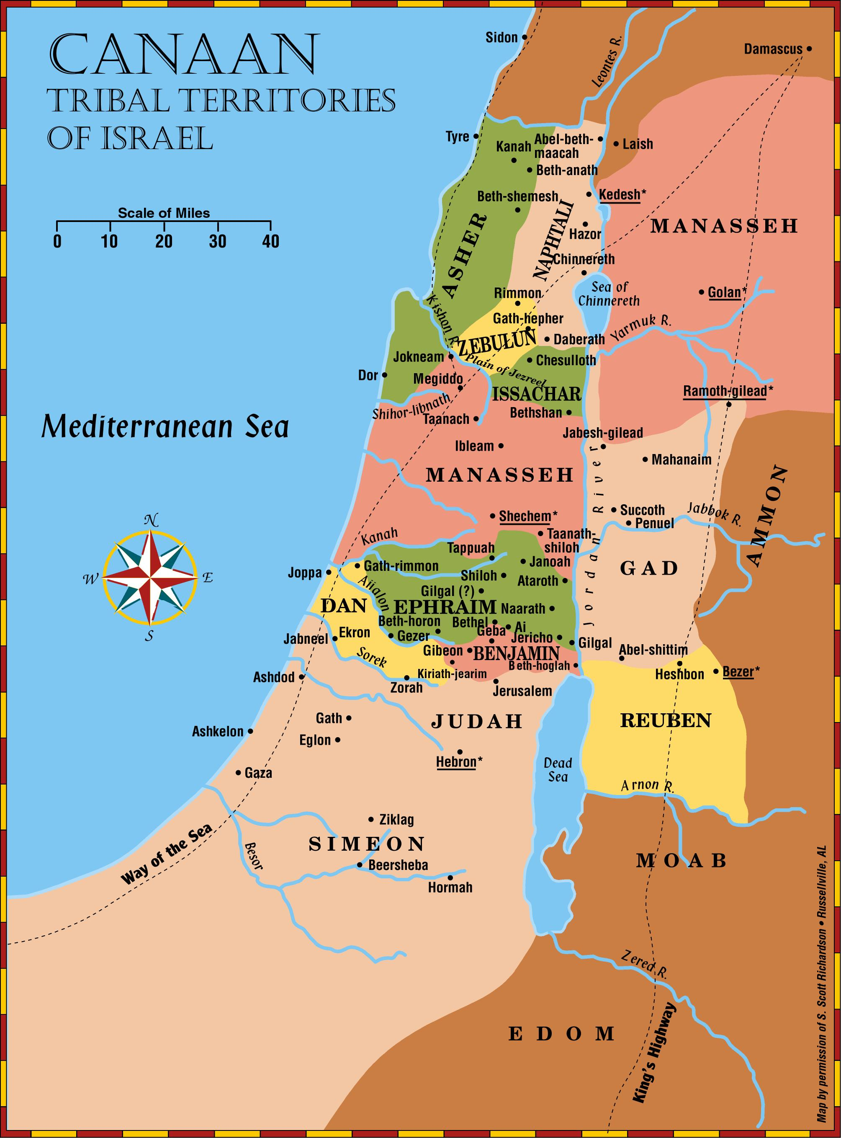
b
Bethlehem in Zebulun. Josh. 19:15
Bethlehem in Judea. Micah 5:2; Mt. 2:5,6

Slide 29
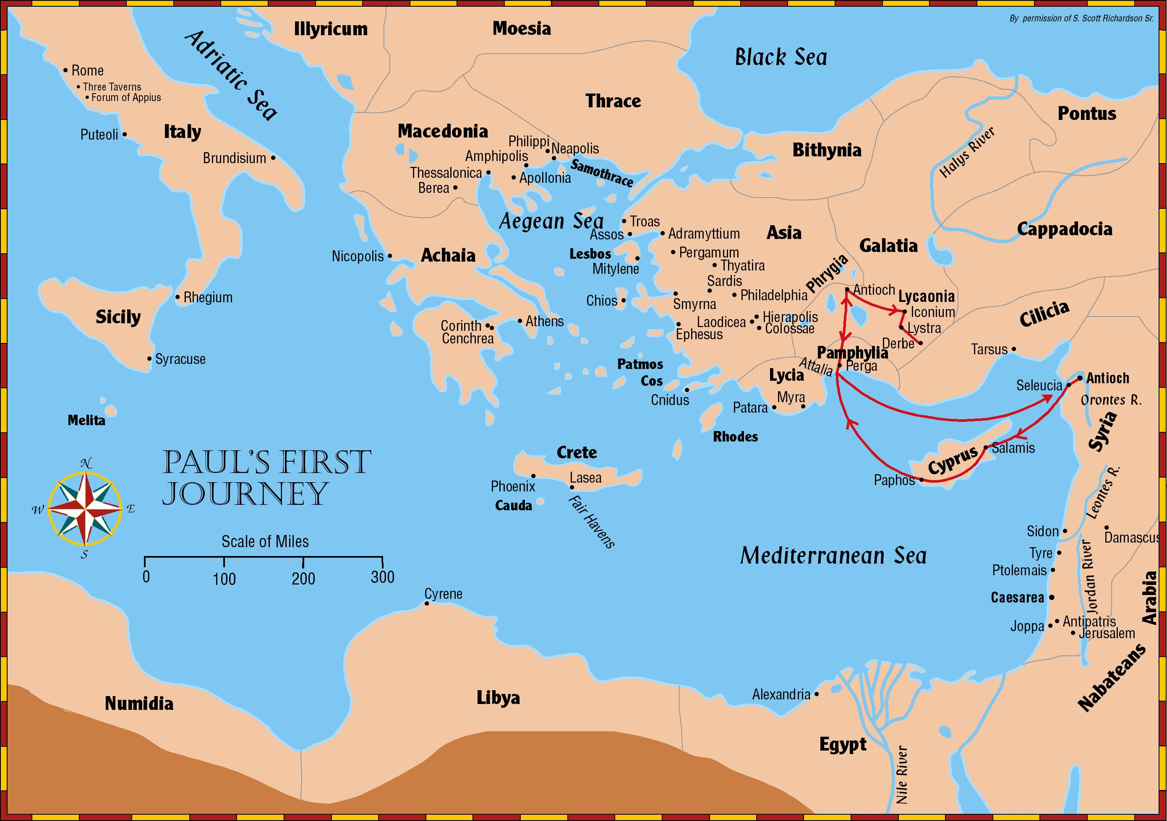
Starts Here
Acts 13-15
Notes:
Over half of the book of Acts details the travels of the apostle Paul. His first preaching tour is in Acts 13 through 15

Slide 30
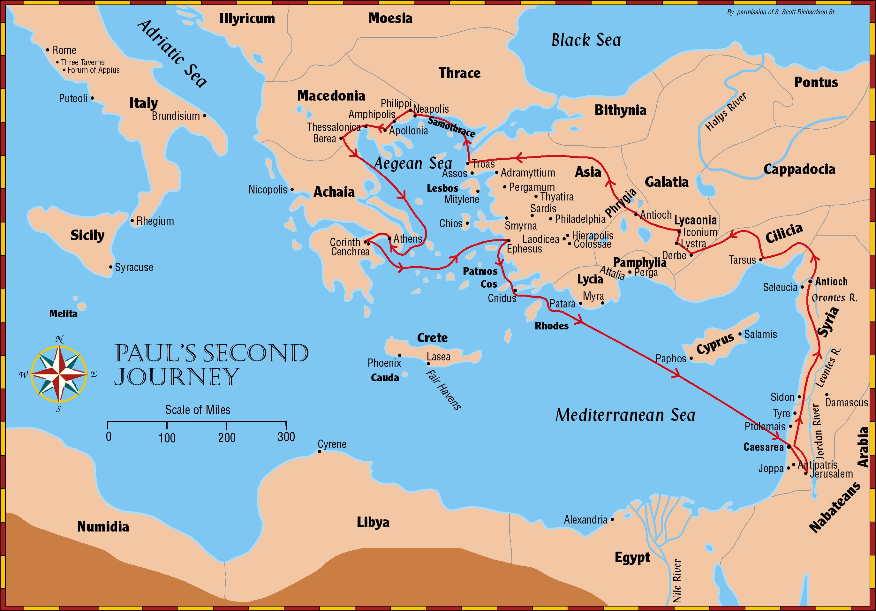
Stats Here
Acts 15-18
Notes:
Paul’s second preaching tour is found in Acts 15 through 18

Slide 31
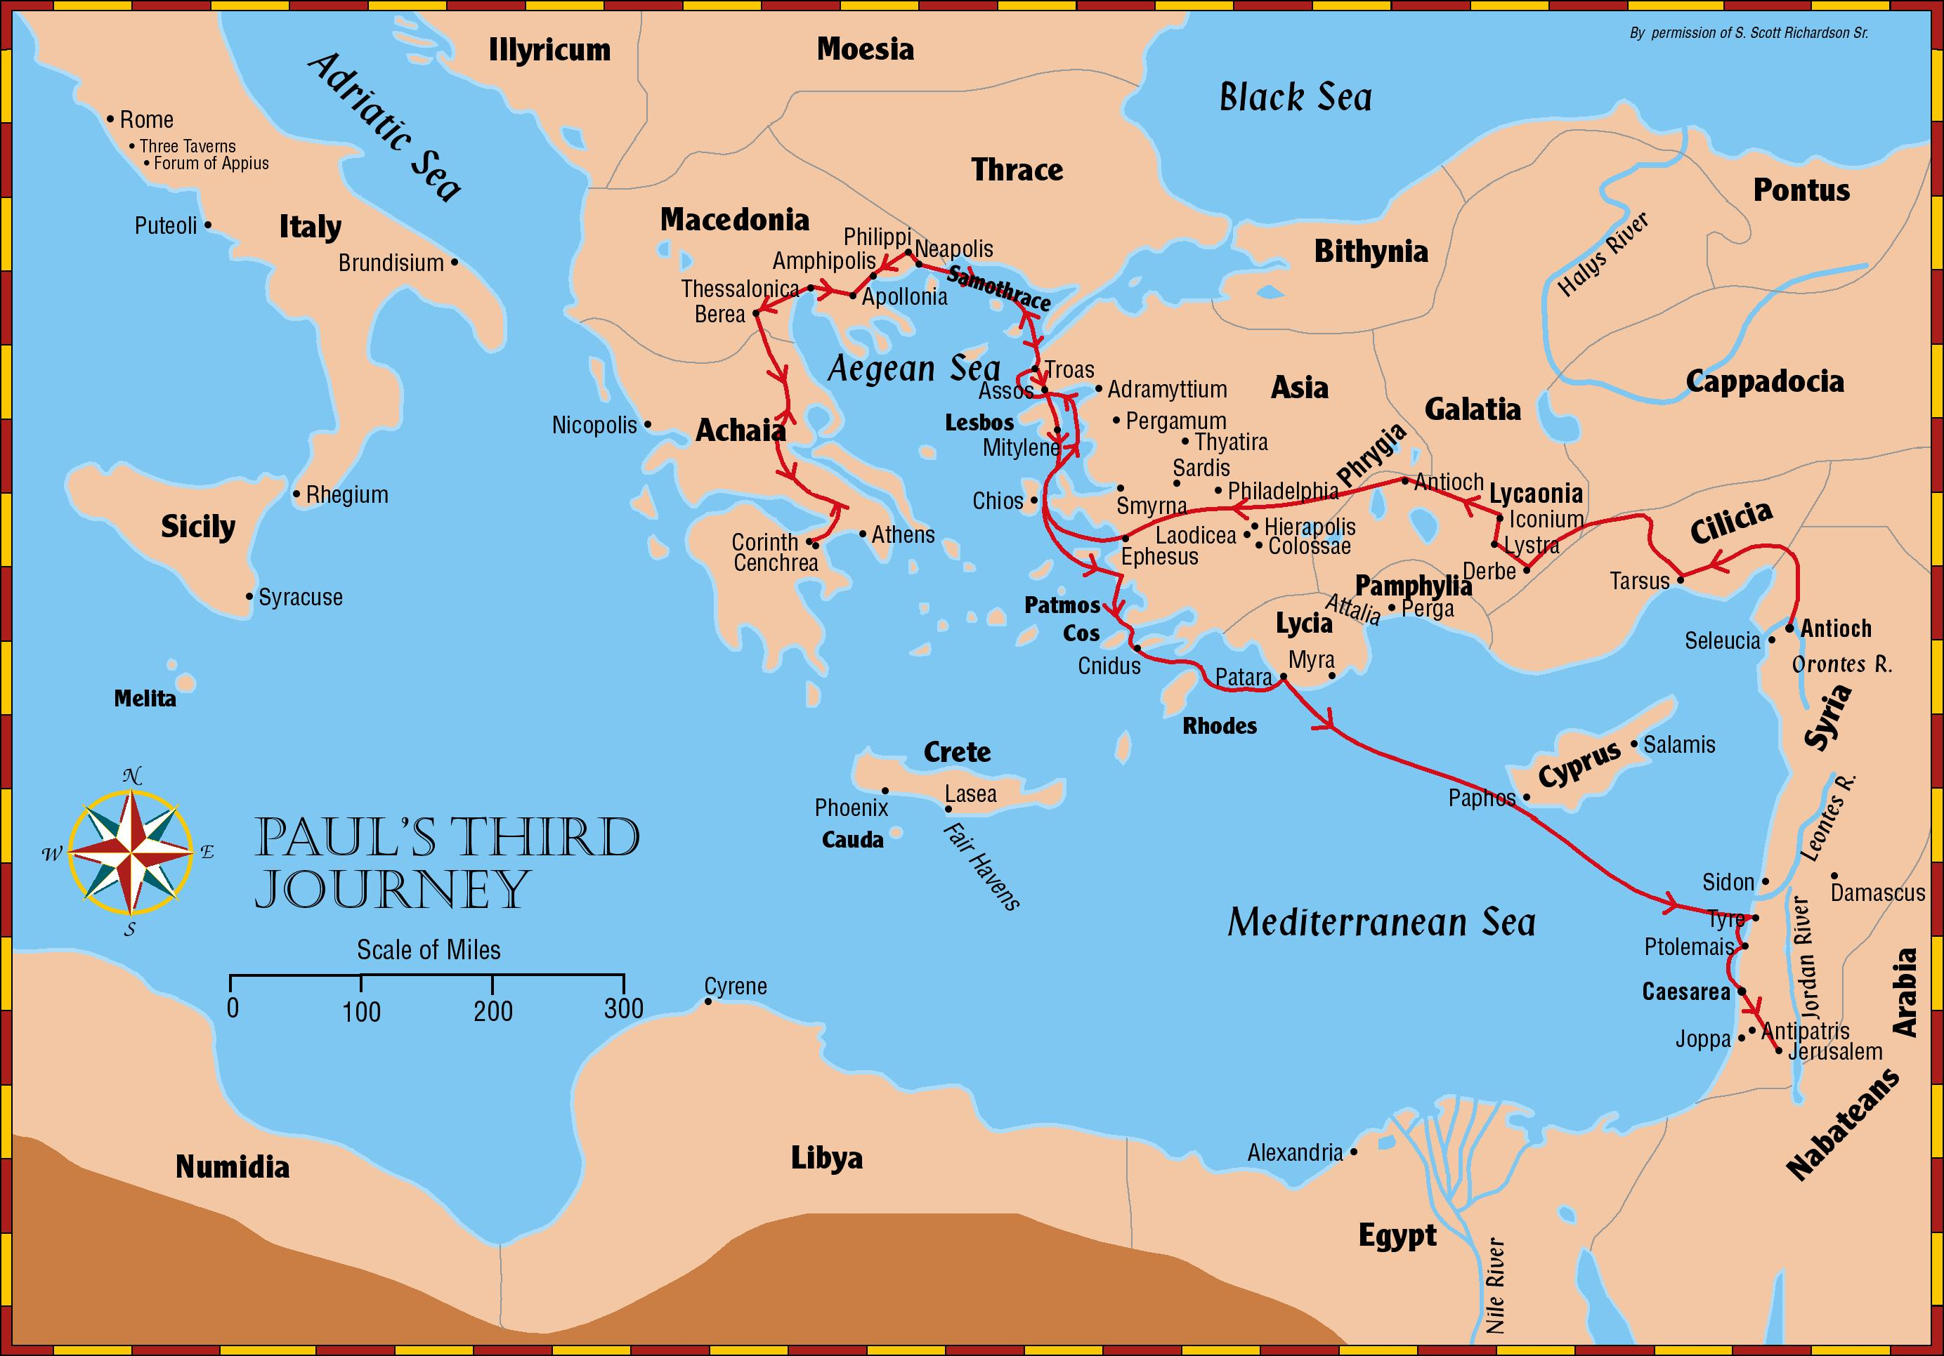
Starts Here
Acts 18-21
Notes:
Paul’s third preaching tour is found in Acts 18 through 21
Acts chapters 27 and 28 detail Paul’s journey to Rome as a prisoner to Rome, from Caesarea to Sidon, past Cypress, to Myra in Lycia, past Cnidus, then to Fair Havens in Lasea on Crete, then past the Island of Clauda, across the Adriatic Sea, then shipwrecked on the island of Malta. After 3 months, to Syracuse in Sicily, then Rhegium in Italy, then to Puteoli, then to the Market of Appius and Three Inns and on to Rome.
As a prisoner in Rome, Paul wrote the letters to the Ephesians, Philippians, Colossians, and Philemon.

Slide 32
Consider Existing Laws, Customs, Or Popular Opinions
1. Existing Roman law provided that a guard found to sleep on duty would be put to death. Hence, to lie about the Lord’s body being stolen placed the soldiers in danger of death. But the Jews promised to “secure you,” Matthew 28:12-15
2. The Jews told Pilate, “We are not permitted to put anyone to death,” John 18:31
  a. This is a reference to the fact the Romans had taken away from them the powers to inflict the death penalty. It does not mean that the Law of Moses did not provide such a penalty (Leviticus 24:16-17).
Notes:
Matthew 28:12-15 And when they had assembled with the elders and consulted together, they gave a large sum of money to the soldiers, ¹³ and said, “You are to say, ‘His disciples came by night and stole Him away while we were asleep.’ ¹⁴ And if this should come to the governor’s ears, we will win him over and keep you out of trouble.” ¹⁵ And they took the money and did as they had been instructed; and this story was widely spread among the Jews, and is to this day.
John 18:31 So Pilate said to them, “Take Him yourselves, and judge Him according to your law.” The Jews said to him, “We are not permitted to put anyone to death,”
Leviticus 24: 16-17 Moreover, the one who blasphemes the name of the Lord shall surely be put to death; all the congregation shall certainly stone him. The alien as well as the native, when he blasphemes the Name, shall be put to death.

Slide 33
Consider The Words Themselves

Slide 34
Each Word Used Has A Purpose
“Now we have received, not the spirit of the world, but the Spirit who is from God, so that we may know the things freely given to us by God, which things we also speak, not in words taught by human wisdom, but in those taught by the Spirit, combining spiritual thoughts with spiritual words.” (1 Corinthians 2:12-13)

Slide 35
Each Word Used Has A Purpose
Don’t Confuse Words…
a. “Strait” means restrained, difficult.
“Enter ye in at the strait gate: for wide is the gate, and broad is the way, that leadeth to destruction, and many there be which go in thereat: Because strait is the gate, and narrow is the way, which leadeth unto life, and few there be that find it.” (Matthew 7:13-14 KJV)
b. “Straight” means upright, not crooked or bent.
“Wherefore lift up the hands which hang down, and the feeble knees; And make straight paths for your feet, lest that which is lame be turned out of the way; but let it rather be healed. Follow peace with all men, and holiness, without which no man shall see the Lord…”
(Hebrews 12:12-14 KJV)

Slide 36
Compare Parallel Passages

Slide 37
Truth Does Not Contradict Truth
Example: Can a rich man go to heaven?
a. Matthew 19:23-24 “It is hard for a rich man to enter the kingdom of heaven.”
b. Mark 1O:23-25 “A rich man” is shown to mean those who trust in their riches. Cf. Proverbs 11:28
c. 1 Timothy 6:9-1O “Those who want to get rich”will be in sin.
d. 1 Timothy 6:17-19 “Those who are rich” who use their money wisely can be saved.
Notes:
Matthew 19:23-24 And Jesus said to His disciples, “Truly I say to you, it is hard for a rich man to enter the kingdom of heaven. ²⁴ Again I say to you, it is easier for a camel to go through the eye of a needle, than for a rich man to enter the kingdom of God.”
Mark 10:23-25 And Jesus, looking around, *said to His disciples, “How hard it will be for those who are wealthy to enter the kingdom of God!” ²⁴ The disciples were amazed at His words. But Jesus *answered again and *said to them, “Children, how hard it is to enter the kingdom of God! ²⁵ It is easier for a camel to go through the eye of a needle than for a rich man to enter the kingdom of God.”
Proverbs 11:28 He who trusts in his riches will fall, But the righteous will flourish like the green leaf.
1 Timothy 6:9-10 But those who want to get rich fall into temptation and a snare and many foolish and harmful desires which plunge men into ruin and destruction. ¹⁰ For the love of money is a root of all sorts of evil, and some by longing for it have wandered away from the faith and pierced themselves with many griefs.
1 Timothy 6:17-19 Instruct those who are rich in this present world not to be conceited or to fix their hope on the uncertainty of riches, but on God, who richly supplies us with all things to enjoy. ¹⁸ Instruct them to do good, to be rich in good works, to be generous and ready to share, ¹⁹ storing up for themselves the treasure of a good foundation for the future, so that they may take hold of that which is life indeed.

Slide 38
Truth Does Not Contradict Truth
Example: What is the purpose of baptism?
a. Salvation –1 Peter 3:21; Mark 16:16
b. To put us into Christ – Galatians 3:26-27
c. To put us into His death – Romans 6:3-4
d. For the remission of sins – Acts 2:38
e. To wash away sins – Acts 22:16
Notes:
1 Peter 3:21 Corresponding to that, baptism now saves you—not the removal of dirt from the flesh, but an appeal to God for a good conscience—through the resurrection of Jesus Christ,
Mark 16:16 He who has believed and has been baptized shall be saved; but he who has disbelieved shall be condemned.
Galatians 3:26-27 For you are all sons of God through faith in Christ Jesus. ²⁷ For all of you who were baptized into Christ have clothed yourselves with Christ.
Romans 6:3-4 Or do you not know that all of us who have been baptized into Christ Jesus have been baptized into His death? ⁴ Therefore we have been buried with Him through baptism into death, so that as Christ was raised from the dead through the glory of the Father, so we too might walk in newness of life.
Acts 2:38 Peter said to them, “Repent, and each of you be baptized in the name of Jesus Christ for the forgiveness of your sins; and you will receive the gift of the Holy Spirit.
Acts 22:12-16 “A certain Ananias, a man who was devout by the standard of the Law, and well spoken of by all the Jews who lived there, ¹³ came to me, and standing near said to me, ‘Brother Saul, receive your sight!’ And at that very time I looked up at him. ¹⁴ And he said, ‘The God of our fathers has appointed you to know His will and to see the Righteous One and to hear an utterance from His mouth. ¹⁵ For you will be a witness for Him to all men of what you have seen and heard. ¹⁶ Now why do you delay? Get up and be baptized, and wash away your sins, calling on His name.’

Slide 39
Helps In Study

Slide 40
Suggestions
(1) A Bible Atlas or Encyclopedia will provide maps and historical information;
(2) A Concordance is essential in finding all parallel passages which use the same word;
(3) A Dictionary will help with most words, but a dictionary of N.T. words defines the specific meaning of the original Greek words;
(4) Commentaries are useful in analyzing who made the statement, to whom, and why. However, caution must be followed with these, for they are simply the work of uninspired men and may have an incorrect interpretation.
(5) Follow all the rules suggested in this lesson and then THINK FOR YOURSELF!

Slide 41
Conclusion:
If you are NOT a Christian…
  Hear the gospel, Romans 10:17
  Believe the gospel, Mark 16:15-16
  Repent of sins, Acts 2:38
  Confess faith in Jesus, Acts 8:36-37
  Be baptized, Acts 22:16; Galatians 3:26-27
Obey the gospel “it is the power of God for salvation…”
Romans 1:16; 2 Thessalonians 1:6-8
Notes:
Romans 10:17 So faith comes from hearing, and hearing by the word of Christ.
Mark 16:1516 And He said to them, “Go into all the world and preach the gospel to all creation. He who has believed and has been baptized shall be saved; but he who has disbelieved shall be condemned.
Acts 2:38 Peter said to them, “Repent, and each of you be baptized in the name of Jesus Christ for the forgiveness of your sins; and you will receive the gift of the Holy Spirit.
Acts 8:36-37 As they went along the road they came to some water; and the eunuch *said, “Look! Water! What prevents me from being baptized?” ³⁷ [And Philip said, “If you believe with all your heart, you may.” And he answered and said, “I believe that Jesus Christ is the Son of God.”]
Acts 22:16 “Now why do you delay? Get up and be baptized, and wash away your sins, calling on His name.’
Galatians 3:26-27 For you are all sons of God through faith in Christ Jesus. ²⁷ For all of you who were baptized into Christ have clothed yourselves with Christ.
Romans 1:16 For I am not ashamed of the gospel, for it is the power of God for salvation to everyone who believes, to the Jew first and also to the Greek.
2 Thessalonians 1:6-8 For after all it is only just for God to repay with affliction those who afflict you, ⁷ and to give relief to you who are afflicted and to us as well when the Lord Jesus will be revealed from heaven with His mighty angels in flaming fire, ⁸ dealing out retribution to those who do not know God and to those who do not obey the gospel of our Lord Jesus.

Slide 42
Conclusion:
If you ARE a Christian…
  Keep doing God’s will, Matthew 7:21
  Continue in His word, John 8:31-32
  Remain obedient, Hebrews 5:9
  Be careful not to fall away, Hebrews 3:12
  Be faithful until death, Revelation 2:10b
Notes:
Matthew 7:21 “Not everyone who says to Me, ‘Lord, Lord,’ will enter the kingdom of heaven, but he who does the will of My Father who is in heaven will enter.
John 8:31-32 So Jesus was saying to those Jews who had believed Him, “If you continue in My word, then you are truly disciples of Mine; ³² and you will know the truth, and the truth will make you free.”
Hebrews 5:9 And having been made perfect, He became to all those who obey Him the source of eternal salvation,
Hebrews 3:12 Take care, brethren, that there not be in any one of you an evil, unbelieving heart that falls away from the living God.
Revelation 2:10b Be faithful until death, and I will give you the crown of life.

